Slide 1
Assignment 1
File created on: 20/08/22 6:48:01 pm GMT-4

Slide 2
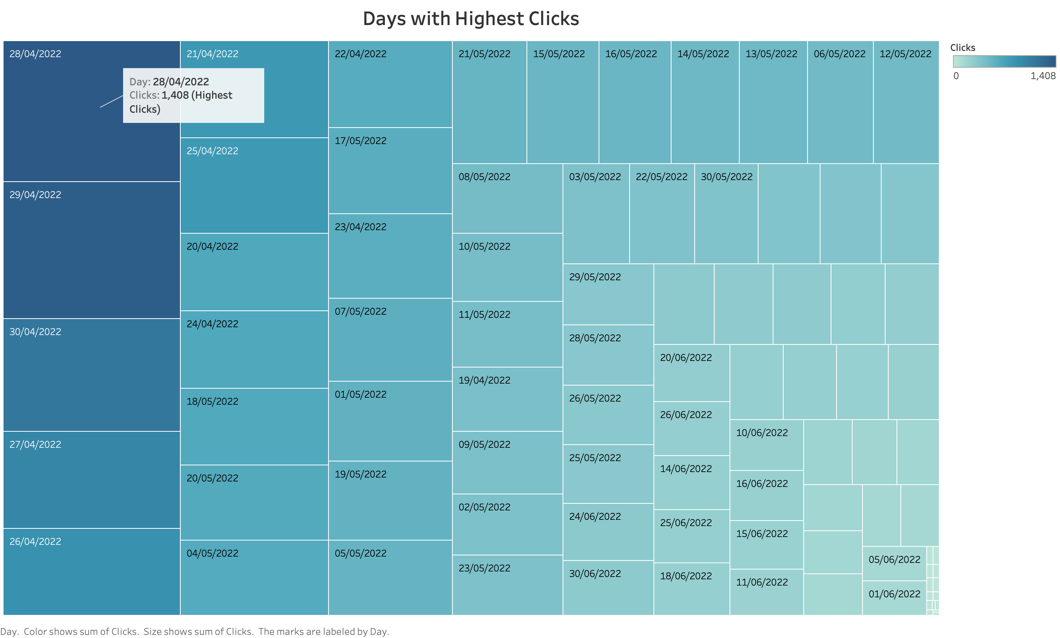

Slide 3
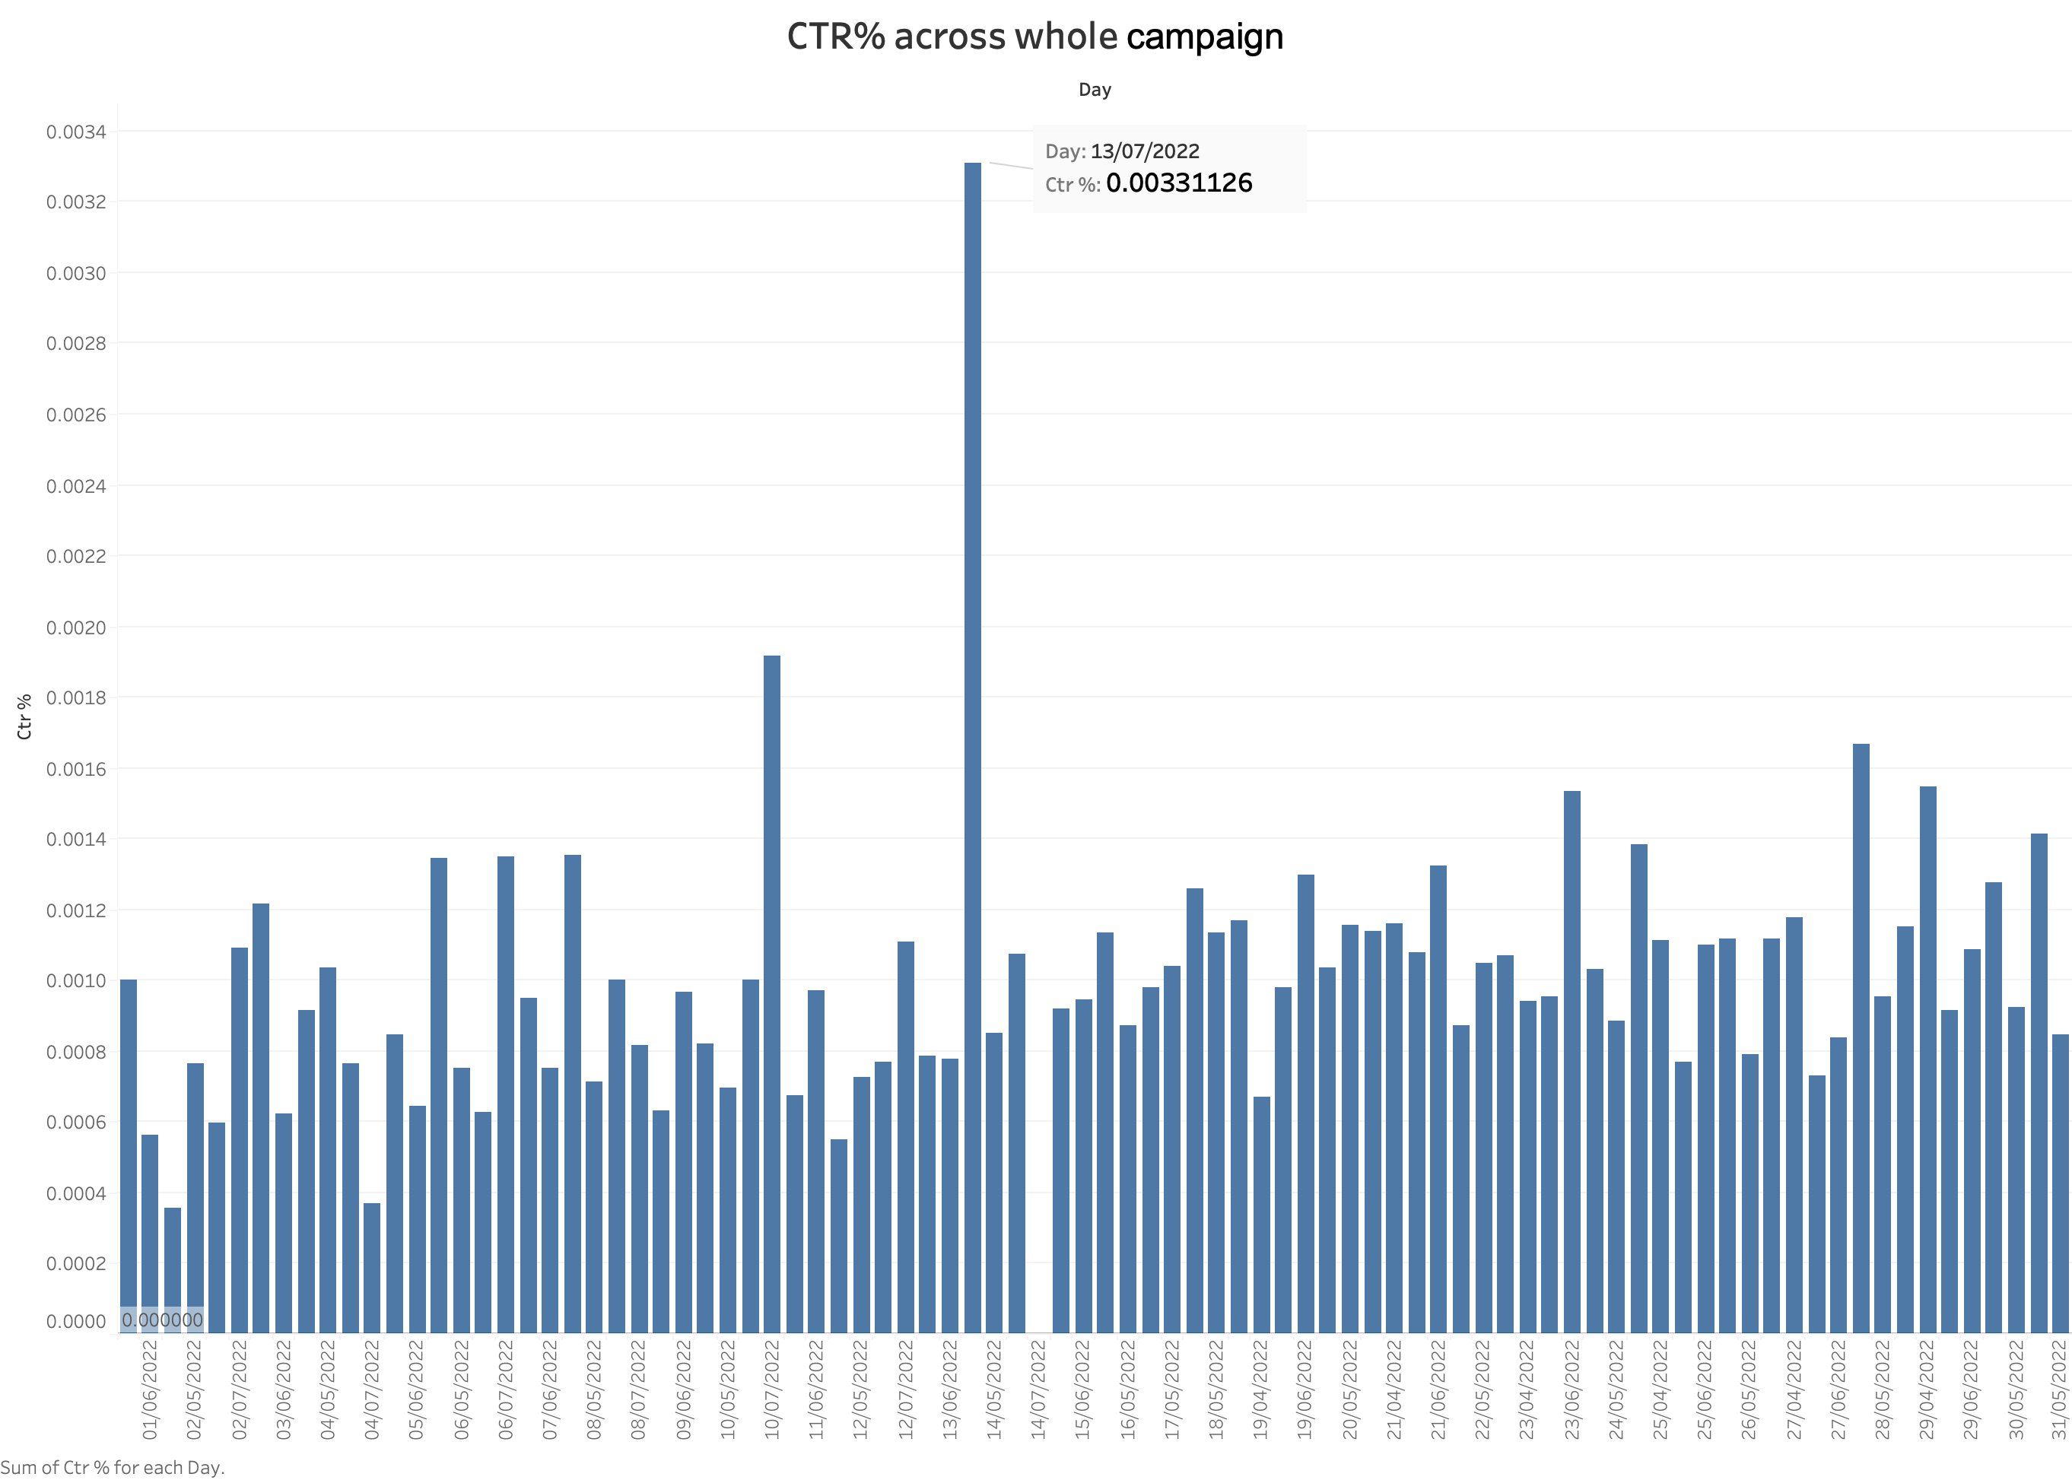

Slide 4
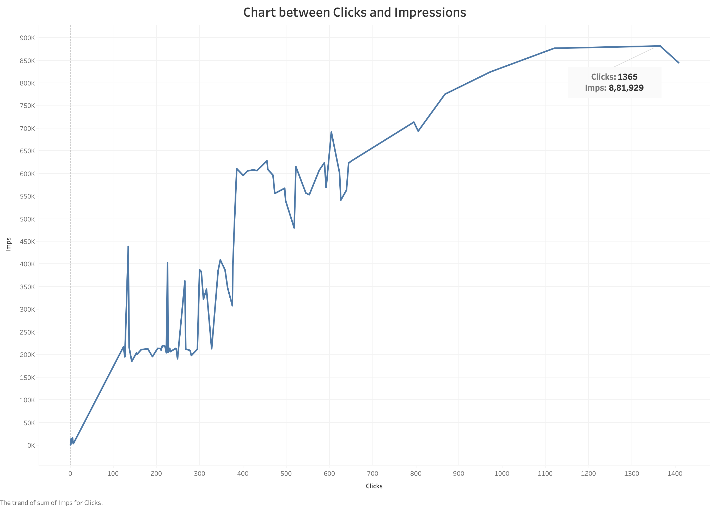

Slide 5
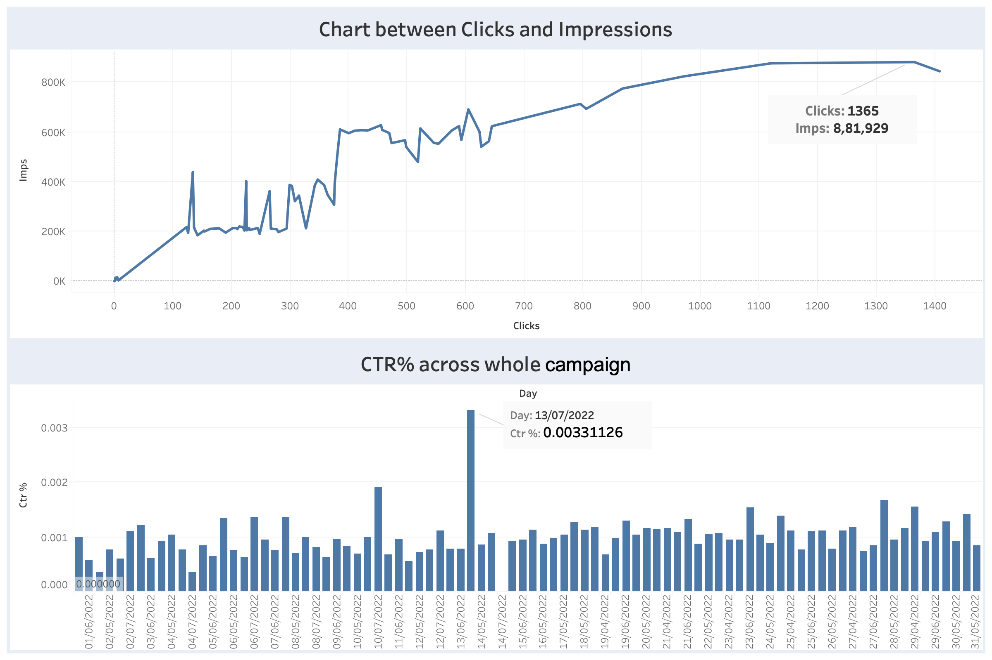

Slide 6
